Slide 1
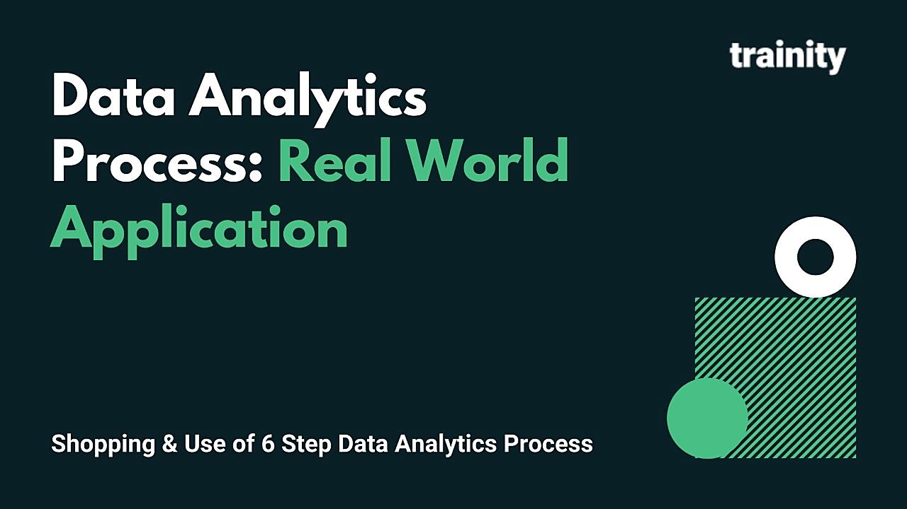

Project Done By Paramesh E

Slide 2
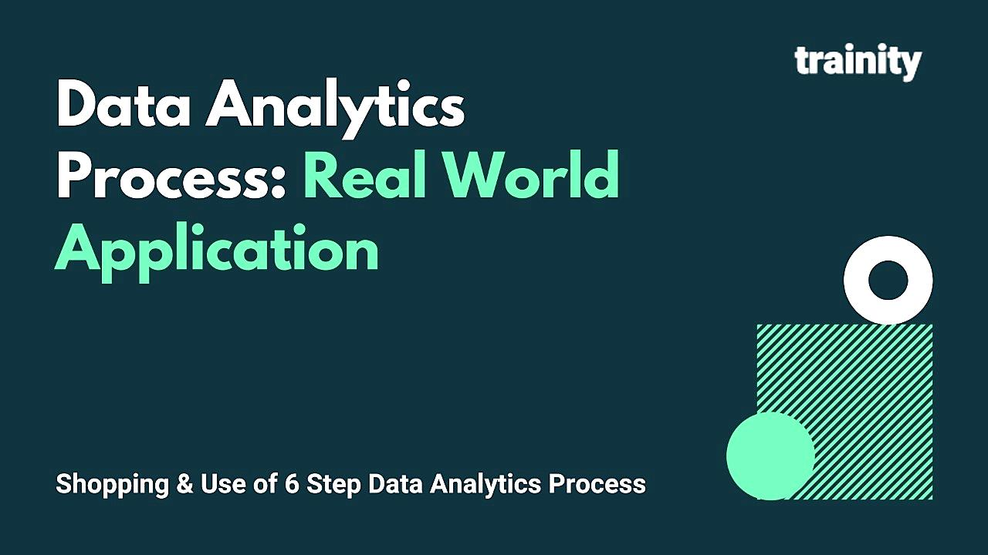
Data Analytics
Data analysis is a process of inspecting, cleansing, transforming, and modelling data with the goal of discovering useful information, informing conclusions, and supporting decision-making.
Data analysis used in different business, ecommerce, technologies, healthcare industries, science, and social science domains, .
In today's business world, data analysis plays a role in making decisions more scientific and helping businesses operate more effectively.
we are using Data Analytics in daily life to enhance productivity and remain profitable.
Lets Discus More about this

Slide 3
Case Study : Data Analytics in Real Life Scenario
task is to give the example of such a real-life situation where we use Data Analytics and link it with the data analytics process. explaining it with the process in Plan, Prepare, Process, Analyze, Share and Act

Slide 4

Scenario
we are living in the era where most of the people having dream to Buy a Car and they do research on this.
they take collect the responses from the people who had already buy the certain brands of car, they take reports on trending features of cars and which brand is trending most, what is the price of the car in the market and etc.
lets Summarize the data analytics we use without knowing it and application of data analytics in daily life.

Slide 5
Scenario : Purchasing a Car
Everyday We Apply Data Analytics Steps Without Knowing It
Let Summarize steps:
Plan
Plan to Buy a Dream Car
Prepare
checking our limitations, how much I am willing to spend and how to get that money
Process
Collecting Data about cars
Analyze
Share
Comparing Between Different Brands and making Decisions
Act
Sharing details with others and To get the Best outcome
Then you finally buy it!

Slide 6

Proceeding with Data Analytics Steps :
Planning : | In Data Analytic, the first approach towards anything we do is planning, we first plan and then process it accordingly. in daily life we do planning before acting, an action without plan can have highest chances of failure, so planning is must. In this example we were planning to buy a car and we are planning it accordingly.

Slide 7

Preparing : | After Planning We must Prepare Our Self for further Procedure Like we do in Analytics We first understand the data and then finalize the necessary steps to take and we Prepare the data for Further steps In this scenario We have to Prepare our self Our Data like Documents Needed to purchase a Car and also in terms of Financially to proceed further step, etc..
Preparation

Slide 8

Analyze : | This is the Most Important step in the analytics and also in day-to-day life In Data Analytics we Spend most of the time In Analyzing, We examine methodically and in detail, do interpretation on the data typically in order to explain the relationships and all the things In this Scenario we do analyzing and Comparing different brands, Cost wise with its Feature and Cars Company with Trending car models, We analyze the reviews and responses that we have taken etc. Then we sort out the all the insights and we will choose the best fit in our limits
Analysis

Slide 9

5. Share : | As in data Analytics we do Discussions with team mate or else with resourceful persons by sharing insights we have got from the data and to get the best outcome, Here in this scenario, do conversation about idea with best persons and having a knowledge in the respected field or a Showrooms executives to get the best suits on our budget and highly admirable
6. Act : | Then you finally buy it! And enjoy the ride with the your loved car

Slide 10
Conclusion :
Data Analytics is holds a much important role in nowadays. In this new a era, billions of data is generating per second, Data helps you understand performance providing the clarity needed for better results. Data helps you improve processes so that you can reduce wasted money and time.
Key takeaways :
Plan it well in detailed manner of timing and resources, used to achieve an objective the best
prepare a brief summary about your work before proceeding
Analysis helps you in order to explore and interpret the matter, methodically and in detail to get the insights
Sharing the views helps you to do correctness and get into right way

Slide 11
THANK YOU
Project Done by
Paramesh E

